Slide 1

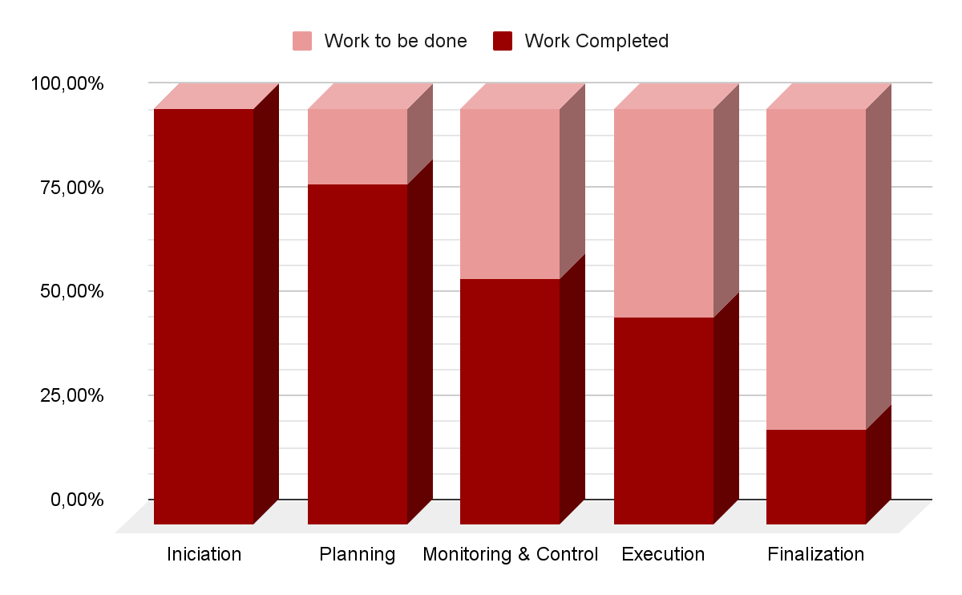
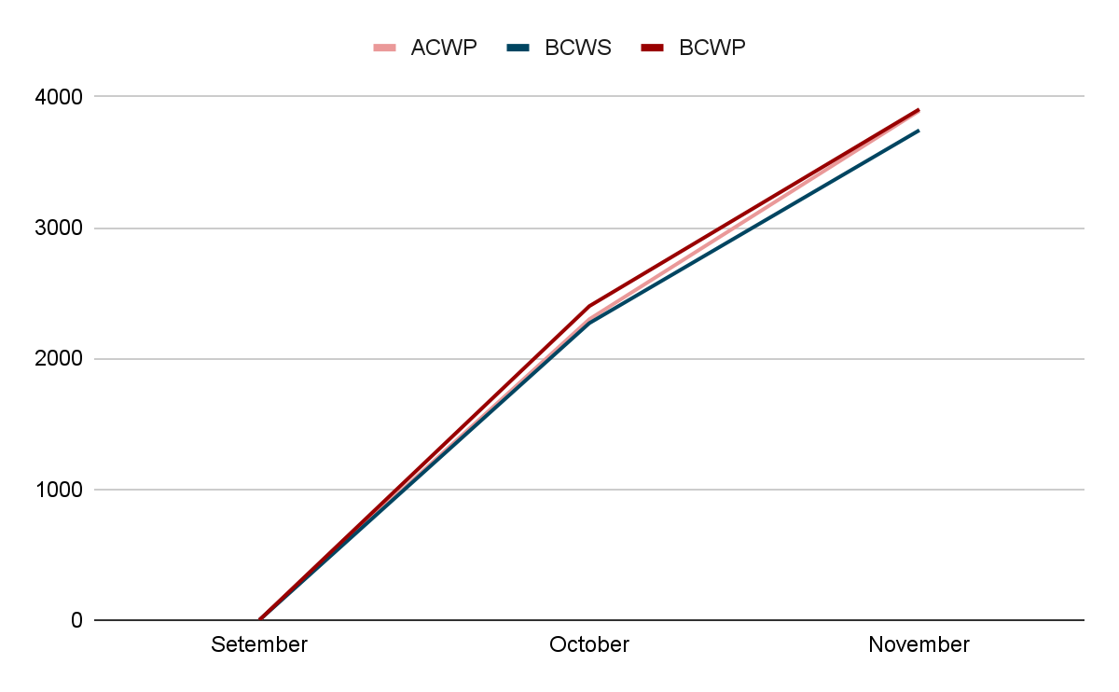
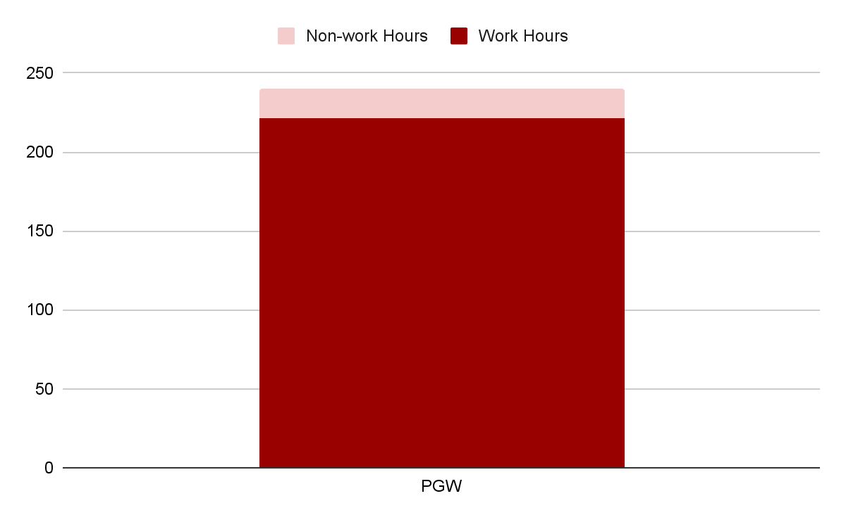
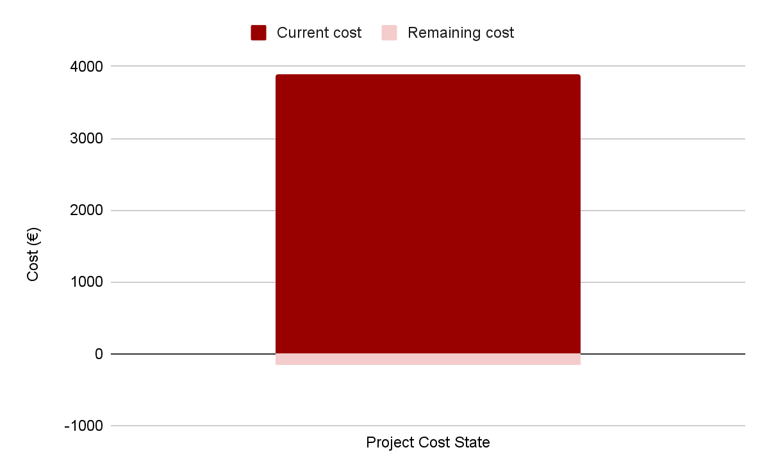
Gestão de Projetos de Tecnologias e Informática (GPTI)
Engenharia de Telecomunicações e Informática
Departamento de Sistemas de Informação - Escola de Engenharia
Project Status Report
Project Phase: Execution
Reporting period: 19/09/2024 to 16/111/2024
Overall Status: Yellow
Project Owner (PO): Department of Information Systems
Business Manager (BM): Professor João Varajão
Project Manager (PM): Catarina Pereira
Project Team (PT)/Solution Provider (SP): Catarina Pereira, Inês Neves, Leonardo Martins and Rodrigo Castillo
Issues
Status: Green
This project has no open situations.
Legend
Completed as planned
Open or under development as planned
Milestones
19/09/2024 - Project Initialization
12/10/2024 - Delivery of Project Charter and Poster
02/11/2024 - Delivery of the 1st version of the Project Plan
16/11/2024 - Delivery of Status/ Control Reports
21/11/2024 - Mock Up Delivery
End Nov - Employee Training
End Nov - Quality Certificate
10/12/2024 - Final Delivery
12/12/2024 - Project Presentation
12/12/2024 - Individual Meeting
Project Status Summary
To date, the project has completed 65% of its tasks.
Deliverables
Application Mockup
User Manual
Application Maintenance Manual
Fully functional mobile application
Source Code of the Application
Project Indicator (at current state)
Status: Yellow
Baseline delivery date: 16th November, 2024
Forecasted delivery date: 16th November, 2024
Project Changes
Status: Green
Category Application - Development of just one interactive game.
Planned Cost (BCWS): 3744,78 Actual Cost (ACWP): 3893,53 Earned Value (BCWP): 3905,04 | Accounting Variance: -148,75 SPI: 1,04 CPI: 1,00
Top Risks
Status: Yellow
Loss of team member: O: 1│I: 5│S:5
Loss of client’s trust: O: 2│I: 5│S:10
Exceeding the stipulated budget: O: 5│I: 3│S:15
Delay in delivering milestones/ deliverables: O: 5│I: 2│S:10
Legend
O: Occurrence I: Impact S: Seriousness | Active Risk Possible Risk
Project Work State
Project Cost State
Academic year: 2024/2025

